Slide 1


Airline Operations & Passenger
Experience Analysis
An end-to-end airline operations analysis using Python
(NumPy, Pandas, Matplotlib) to study flight delays, regional and
seasonal patterns, and passenger impact, supported by a clear
dashboard for operational decision-making.
SUPRATIM MAITY

Slide 2
Project Objectives
The objective of this project is to perform an end-to-end analysis of airline operations and passenger experience using Python.
The analysis focuses on understanding flight punctuality, regional performance, seasonal trends, and passenger impact in order to identify operational inefficiencies and improvement opportunities.
The key objectives of this project are:
To analyze the overall distribution of flight statuses (On Time, Delayed, Cancelled).
To examine how flight delays vary across different continents.
To identify seasonal patterns in flight delays using monthly trend analysis.
To study how flight disruptions affect different passenger age groups.
To design a clear and informative dashboard that summarizes key operational metrics.
To derive actionable insights that support data-driven decision-making in airline operations.

Slide 3
Business Problem
Airline operations are highly sensitive to delays and cancellations, which directly impact customer satisfaction, operational costs, and brand reputation.
Despite having large volumes of operational data, airlines often face challenges in identifying where disruptions occur most frequently, when they are likely to happen, and which passenger groups are most affected.
The key business problems addressed in this project are:
Assessing the overall reliability of airline operations.
Identifying regions and continents with higher delay rates.
Understanding seasonal patterns that contribute to operational disruptions.
Evaluating the impact of flight delays on different passenger age groups.
Providing decision-makers with a clear and consolidated view of operational performance.
Supporting proactive planning to reduce delays and improve passenger experience.

Slide 4
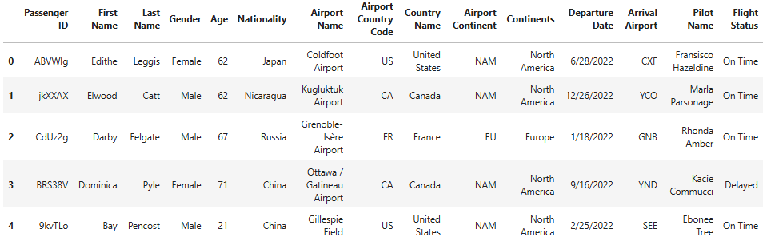
1. Import Libraries
# Importing Libraries
import pandas as pd
import numpy as np
import matplotlib.pyplot as plt
2. Load Dataset
# To Load And View The Dataset
df = pd.read_csv('Airline Dataset.csv')
df.head()
OUTPUT →

Slide 5
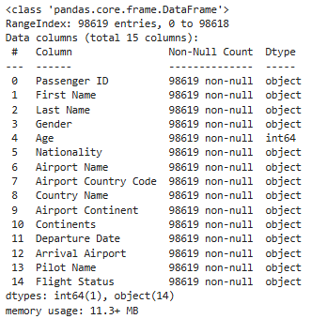
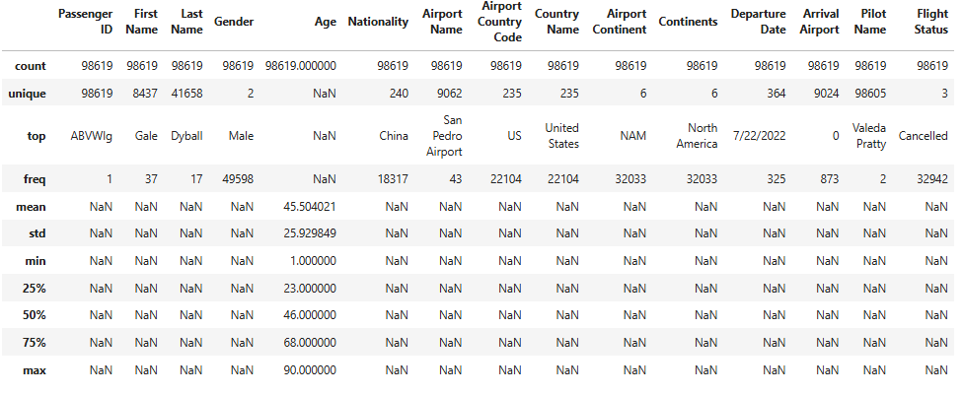
3. Data Understanding
# To understand the size of the dataset
df.shape
OUTPUT →
# Provides a concise summary of the DataFrame.
df.info()
OUTPUT →
# Generates descriptive statistics for all columns, including numerical and categorical data.
df.describe(include='all')
OUTPUT →

Slide 6
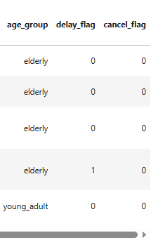
4. Data Cleaning & Standardisation
# Data cleaning & preprocessing to make the dataset consistent, reliable, and analysis-ready.
text_cols = [
'Gender','Nationality','Airport Name','Country Name',
'Airport Continent','Continents','Pilot Name','Flight Status'
]
df[text_cols] = df[text_cols].fillna('unknown')
for col in text_cols:
df[col] = df[col].str.lower().str.strip()
df['Departure Date'] = pd.to_datetime(df['Departure Date'], errors='coerce')
df.drop_duplicates(inplace=True)
5. Feature Engineering
# Transforming raw data into meaningful categorical and numerical features for analysis and modeling.
df['age_group'] = pd.cut(
df['Age'],
bins=[0,18,30,45,60,100],
labels=['teen','young_adult','adult','senior','elderly']
)
df['delay_flag'] = np.where(df['Flight Status']=='delayed',1,0)
df['cancel_flag'] = np.where(df['Flight Status']=='cancelled',1,0)
df.head()
OUTPUT →

Slide 7
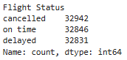
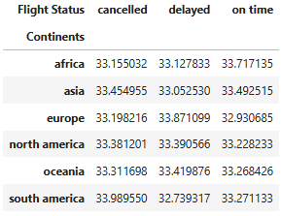
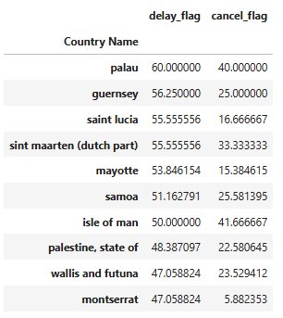
6. Overall Flight Status Distribution
# This code counts how many flights fall into each flight status (e.g., on-time, delayed, cancelled).
flight_dist = df['Flight Status'].value_counts()
flight_dist
OUTPUT →
7. Continental Performance Analysis
# This code shows how flight statuses are distributed across each continent, in percentage form.
continent_status = pd.crosstab(
df['Continents'],
df['Flight Status'],
normalize='index'
) * 100
continent_status
OUTPUT →
8. Country-Level Risk Analysis
# This code identifies the countries with the highest flight risk based on delays and cancellations.
country_risk = df.groupby('Country Name')[['delay_flag','cancel_flag']].mean() * 100
country_risk.sort_values(by='delay_flag', ascending=False).head(10)
OUTPUT →

Slide 8
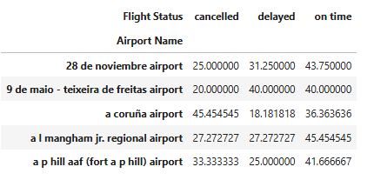
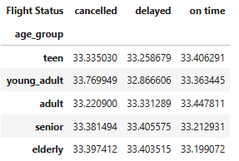
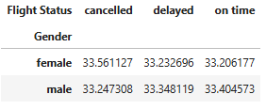
9. Airport Performance Analysis
# This code measures how well each airport is performing based on flight outcomes.
airport_perf = pd.crosstab(
df['Airport Name'],
df['Flight Status'],
normalize='index'
) * 100
airport_perf.fillna(0).head()
OUTPUT →
10. Passenger Demographic Impact
# This code shows how flight outcomes differ by passenger age group, in percentages.
pd.crosstab(
df['age_group'],
df['Flight Status'],
normalize='index'
) * 100
OUTPUT →
Gender vs Flight Status
# This code compares flight outcomes across genders, using percentages.
pd.crosstab(
df['Gender'],
df['Flight Status'],
normalize='index'
) * 100
OUTPUT →

Slide 9
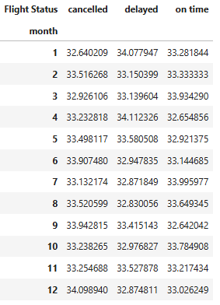
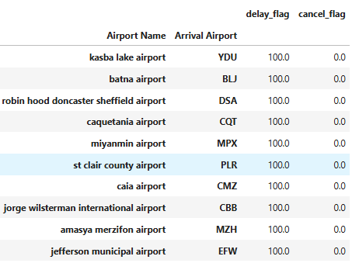
11. Time-Based (Seasonality) Analysis
# This code analyzes how flight performance changes month by month.
df['month'] = df['Departure Date'].dt.month
monthly_status = pd.crosstab(
df['month'],
df['Flight Status'],
normalize='index'
) * 100
monthly_status
OUTPUT →
12. Route-Level Risk Analysis
# This code finds the riskiest flight routes based on delays and cancellations.
route_risk = df.groupby(
['Airport Name','Arrival Airport']
)[['delay_flag','cancel_flag']].mean() * 100
route_risk.sort_values(by='delay_flag', ascending=False).head(10)
OUTPUT →

Slide 10
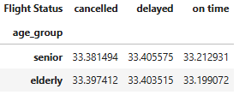
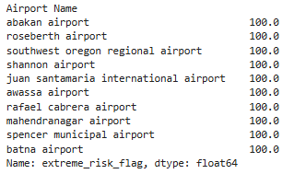
13. Passenger Vulnerability (Senior Impact)
# This code focuses only on senior and elderly passengers to see how their flights perform.
pd.crosstab(
df[df['age_group'].isin(['senior','elderly'])]['age_group'],
df[df['age_group'].isin(['senior','elderly'])]['Flight Status'],
normalize='index'
) * 100
OUTPUT →
14. Extreme Risk Zone Detection
# This code identifies airports with the highest overall disruption risk.
df['extreme_risk_flag'] = np.where(
(df['delay_flag']==1) | (df['cancel_flag']==1),
1, 0
)
extreme_airports = df.groupby('Airport Name')['extreme_risk_flag'].mean() * 100
extreme_airports.sort_values(ascending=False).head(10)
OUTPUT →

Slide 11
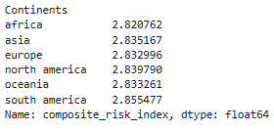
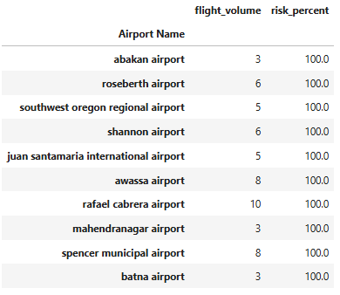
15. Composite Airline Risk Index
# This code creates a single risk score and compares it across continents.
df['composite_risk_index'] = (
df['delay_flag']*2 +
df['cancel_flag']*5 +
df['age_group'].isin(['senior','elderly']).astype(int)
)
df.groupby('Continents')['composite_risk_index'].mean()
OUTPUT →
16. Risk vs Volume Paradox
# This code compares airport traffic volume with disruption risk.
airport_volume = df['Airport Name'].value_counts()
risk_volume = pd.DataFrame({
'flight_volume': airport_volume,
'risk_percent': extreme_airports
}).dropna()
risk_volume.sort_values(by='risk_percent', ascending=False).head(10)
OUTPUT →

Slide 12
17. DASHBOARD
# =========================
# Color Theme
# =========================
DARK = "#343a40"
MID = "#495057"
LIGHT = "#6c757d"
# =========================
# Figure & Layout
# =========================
fig, axes = plt.subplots(2, 2, figsize=(16, 12))
fig.suptitle(
"Airline Operations & Passenger Experience Dashboard",
fontsize=16,
fontweight='bold',
color=DARK
)
# =========================
# Plot 1: Flight Status Distribution
# =========================
axes[0,0].pie(
flight_dist.values,
labels=flight_dist.index,
autopct='%1.1f%%',
startangle=90,
colors=[DARK, MID, LIGHT],
wedgeprops={'edgecolor': 'white'}
)
axes[0,0].set_title("Flight Status Distribution", color=DARK)
axes[0,0].axis('equal')
# =========================
# Plot 2: Delay % by Continent
# =========================
continent_status['delayed'].plot(
kind='bar',
ax=axes[0,1],
color=MID
)
axes[0,1].set_title("Delay Percentage by Continent", color=DARK)
axes[0,1].set_xlabel("Continent")
axes[0,1].set_ylabel("Delay %")
for bar in axes[0,1].patches:
axes[0,1].text(
bar.get_x() + bar.get_width()/2,
bar.get_height(),
f"{bar.get_height():.1f}",
ha='center',
va='bottom',
fontsize=9,
color=DARK
)

Slide 13
# =========================
# Plot 3: Monthly Delay Trend
# =========================
axes[1,0].plot(
monthly_status.index,
monthly_status['delayed'],
marker='o',
linewidth=2,
color=DARK
)
axes[1,0].set_title("Monthly Delay Trend", color=DARK)
axes[1,0].set_xlabel("Month")
axes[1,0].set_ylabel("Delay %")
for x, y in zip(monthly_status.index, monthly_status['delayed']):
axes[1,0].text(
x,
y,
f"{y:.1f}",
ha='center',
va='bottom',
fontsize=9,
color=DARK
)
# =========================
# Plot 4: Age Group vs Flight Status
# =========================
pd.crosstab(
df['age_group'],
df['Flight Status']
).plot(
kind='bar',
stacked=True,
ax=axes[1,1],
color=[DARK, MID, LIGHT]
)
axes[1,1].set_title("Age Group vs Flight Status", color=DARK)
axes[1,1].set_xlabel("Age Group")
axes[1,1].set_ylabel("Number of Flights")
for container in axes[1,1].containers:
axes[1,1].bar_label(container, label_type='center', fontsize=8, color='white')
# =========================
# Final Formatting
# =========================
for ax in axes.flat:
ax.spines['top'].set_visible(False)
ax.spines['right'].set_visible(False)
ax.grid(axis='y', alpha=0.2)
ax.tick_params(colors=DARK)
plt.tight_layout(rect=[0, 0, 1, 0.95])
plt.show()

Slide 14
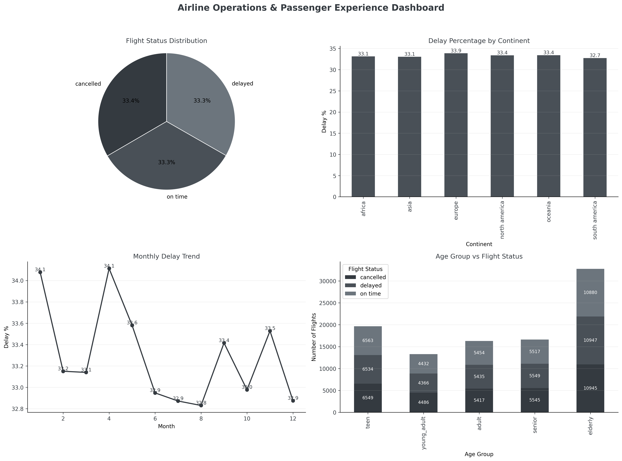

Slide 15
Key Insights & Business Recommendations
🔍 Key Insights
1. A noticeable proportion of flights experience delays, indicating room for improvement in overall airline punctuality.
2. Delay percentages vary significantly across continents, suggesting that regional infrastructure and operational factors influence performance.
3. Monthly trend analysis highlights seasonal fluctuations in delay rates, with certain months consistently showing higher disruption levels.
4. Seasonal peaks reveal periods of operational stress that require proactive planning.
5. Passenger impact analysis shows that flight disruptions are not evenly distributed across age groups, with some segments being more affected than others.
6. The dashboard demonstrates that overall performance, regional behavior, seasonality, and passenger demographics are closely interconnected.

Slide 16
✅ Recommendations
Based on the findings from this analysis, the following recommendations are proposed:
1. Prioritize operational improvements in regions with consistently higher delay percentages.
2. Implement additional staffing, scheduling buffers, and contingency planning during high-delay months.
3. Strengthen passenger communication and assistance strategies for age groups more affected by disruptions.
4. Use operational dashboards regularly to monitor performance trends and support timely decision-making.
5. Conduct periodic performance reviews using historical delay patterns to anticipate operational challenges.
6. Enhance future analyses by incorporating delay duration, root causes, or cost-related data when available.

Slide 17

THANK YOU
This project demonstrates the impact of data-driven analysis in improving airline operations and passenger experience. Thank you for your time and attention.

